Slide 1
HR Analytics
Group: 14
Team Members: Sri Sai Alekya Ghanta, Sahil Kumar Rao, Sarvesh Rajwade, Varun Shrivastava, Pakshal Shah, Jarrar Haider
Presentation Date: December 8, 2022

Slide 2

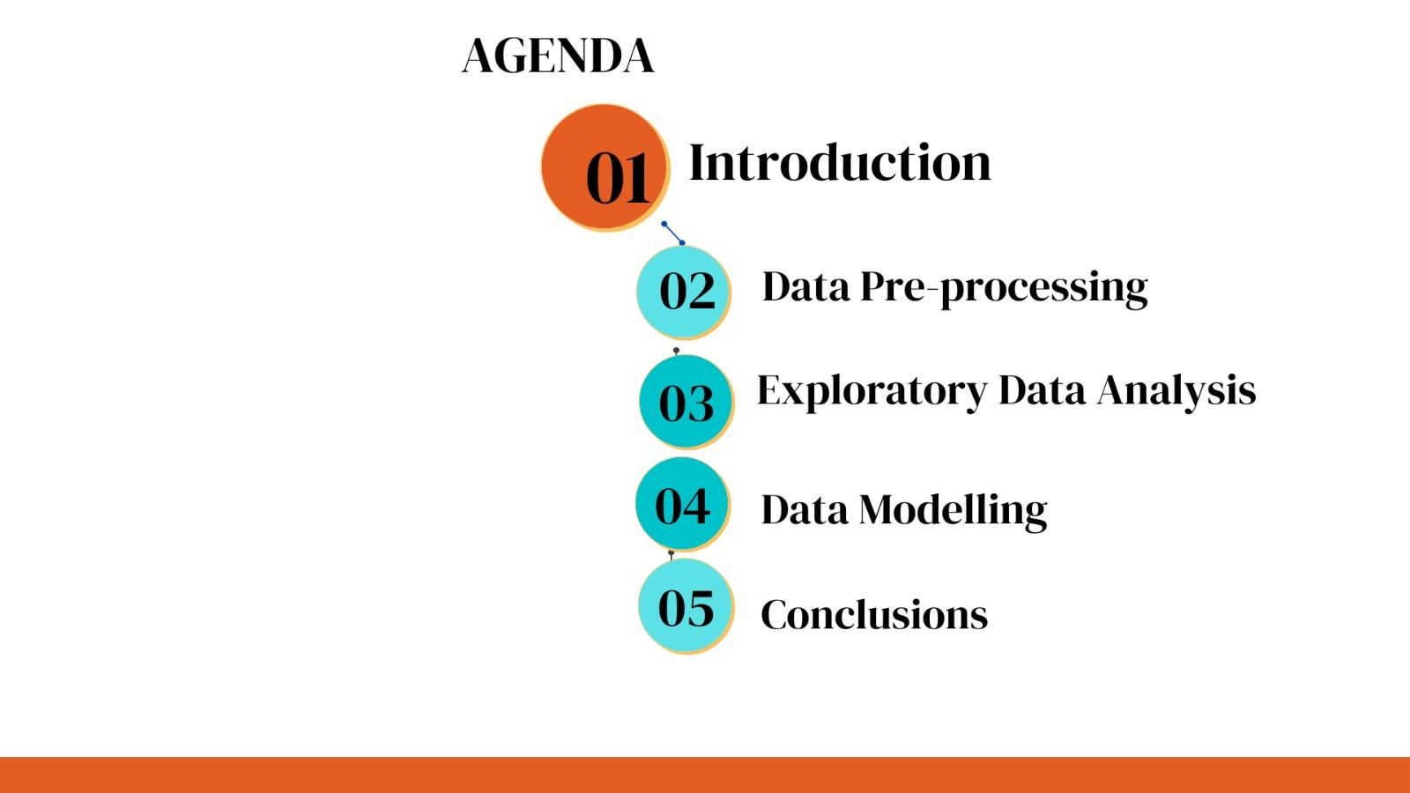

Slide 3
Background
Dataset
Data Source
Users
This dataset is for the HR Department
It contains information about employees who are working or have worked in the company
Data was obtained in the CSV format from Kaggle and imported to Python
Founders and CEO
Leadership Team
HR Team

Slide 4
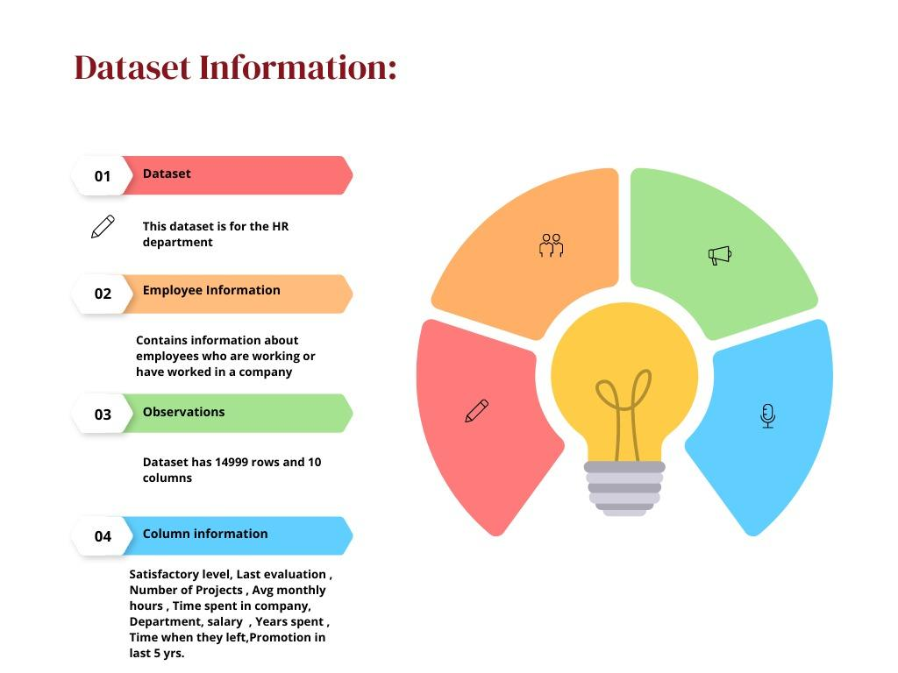
Dataset Information

Slide 5
Mission Objectives
Perform Exploratory Data Analysis to identify key drivers of employee retention.
Build a predictive model to predict employee attrition.
Measure the model accuracy.
Communicate key insights to upper management

Slide 6
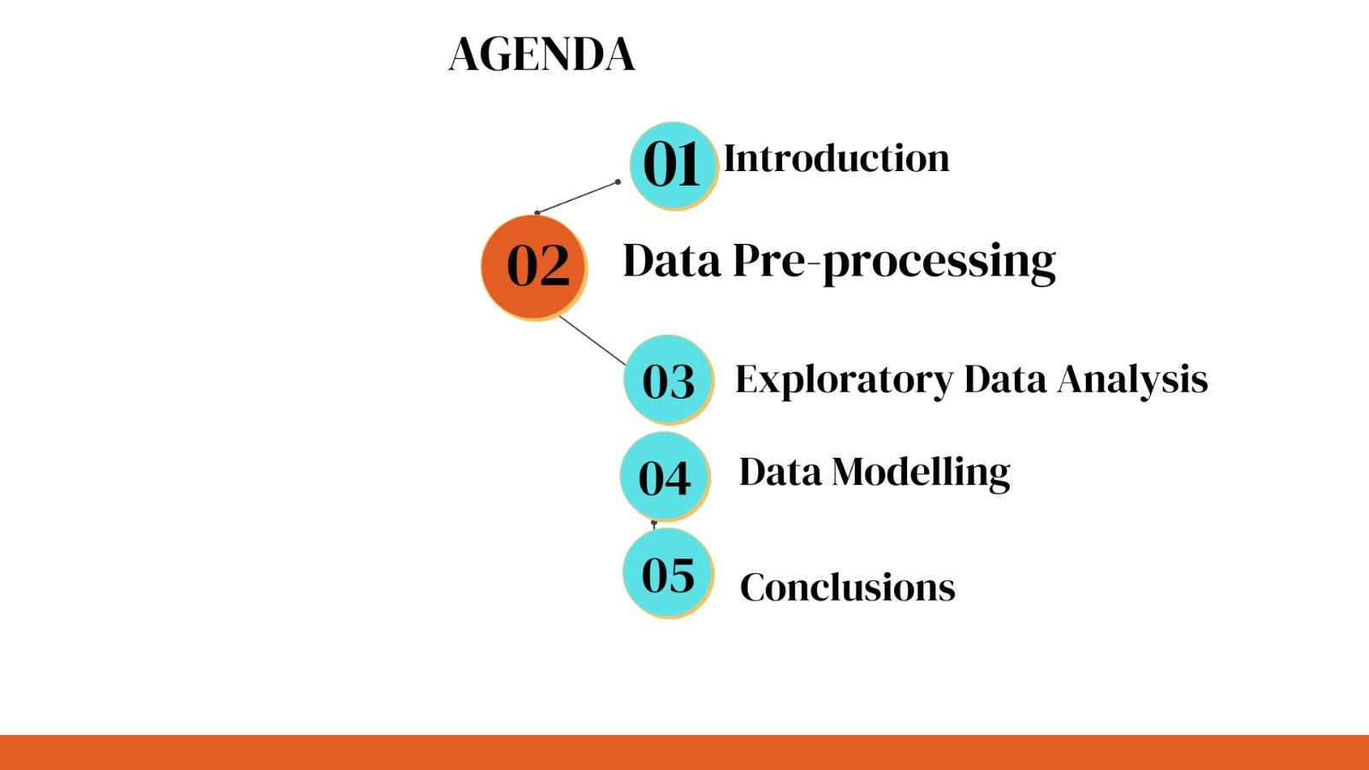

Slide 7

Data Cleaning
Transformed Categorical variables like Salary and Department by creating dummy variables
Performed data cleaning by filtering the data for null values and removing columns of less importance
14999
Number of rows before deduplicating
11991
Number of rows after deduplicating
10
Number of columns in raw data
9
Number of columns taken for modelling

Slide 8
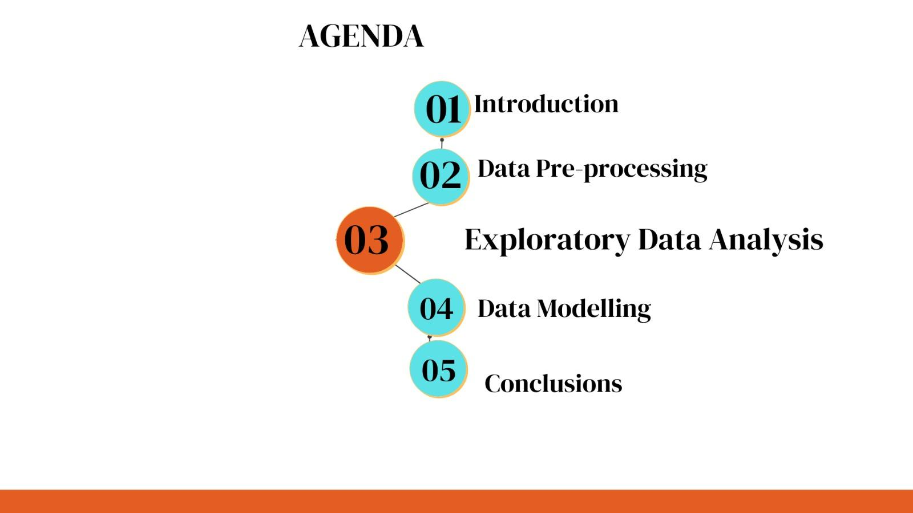

Slide 9
Employee Statistics
Number of employees who left: 1991
Number of employees who were not promoted: 11788
Number of employees in each salary bracket: Low-5750, Medium:5261, High: 990
Number of employees who did not meet with an accident at work: 10141
Number of employees who stayed: 10000
Number of employees who were promoted: 203
Number of employees who met with an accident at work: 1850

Slide 10
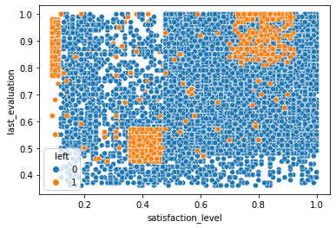
There are employees who left despite having high satisfaction levels and a high evaluation score

Slide 11
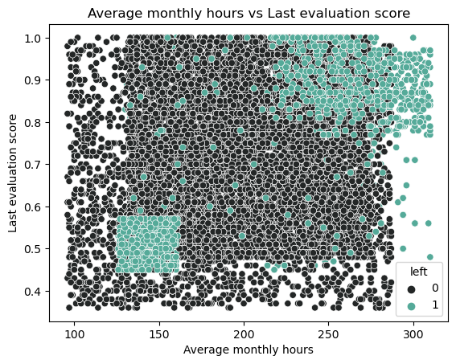
Even though some users had a high evaluation score, they left as they had high average monthly hours

Slide 12
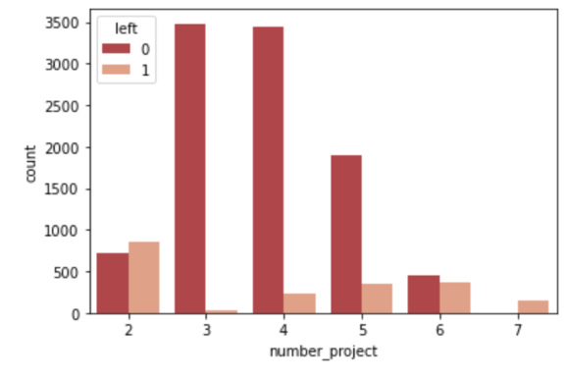
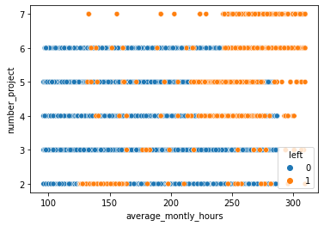
Attrition statistics based on workload
Employee count vs No of projects
No of projects vs Average monthly hours

Slide 13
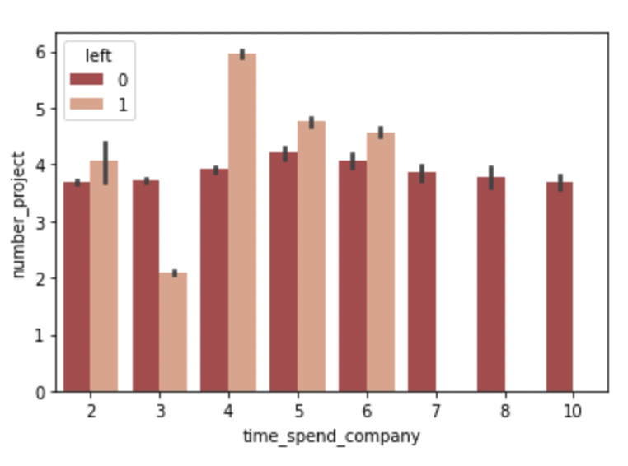
Number of projects vs time spent in the company

Slide 14
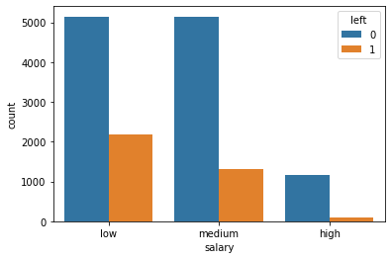

People with salaries at the lower end are more inclined to leave

Slide 15

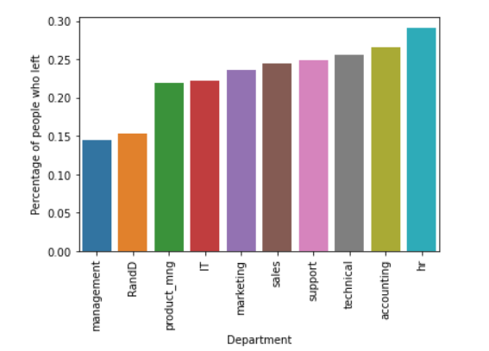
Is HR the most underpaid department?
Why people in the management don’t leave?

Slide 16
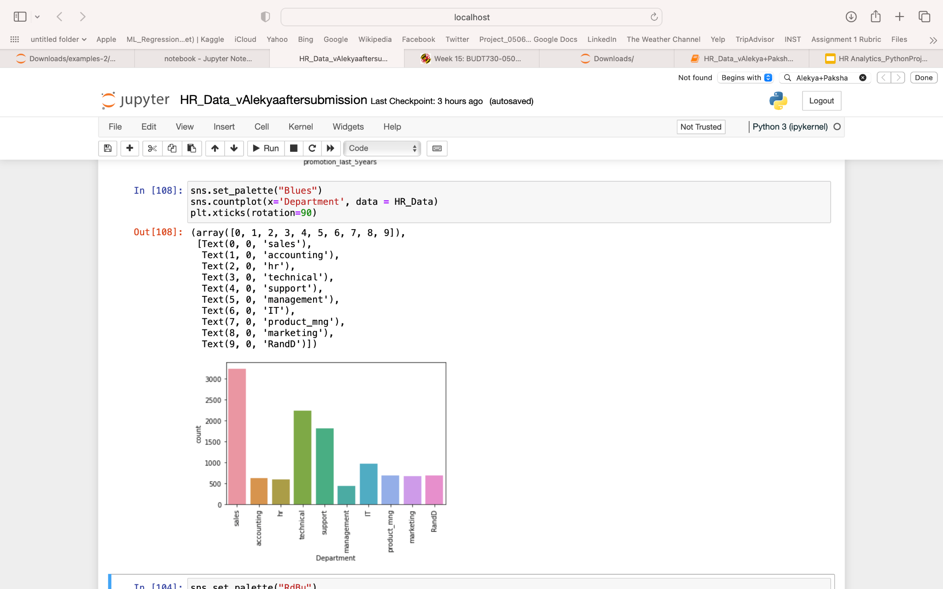
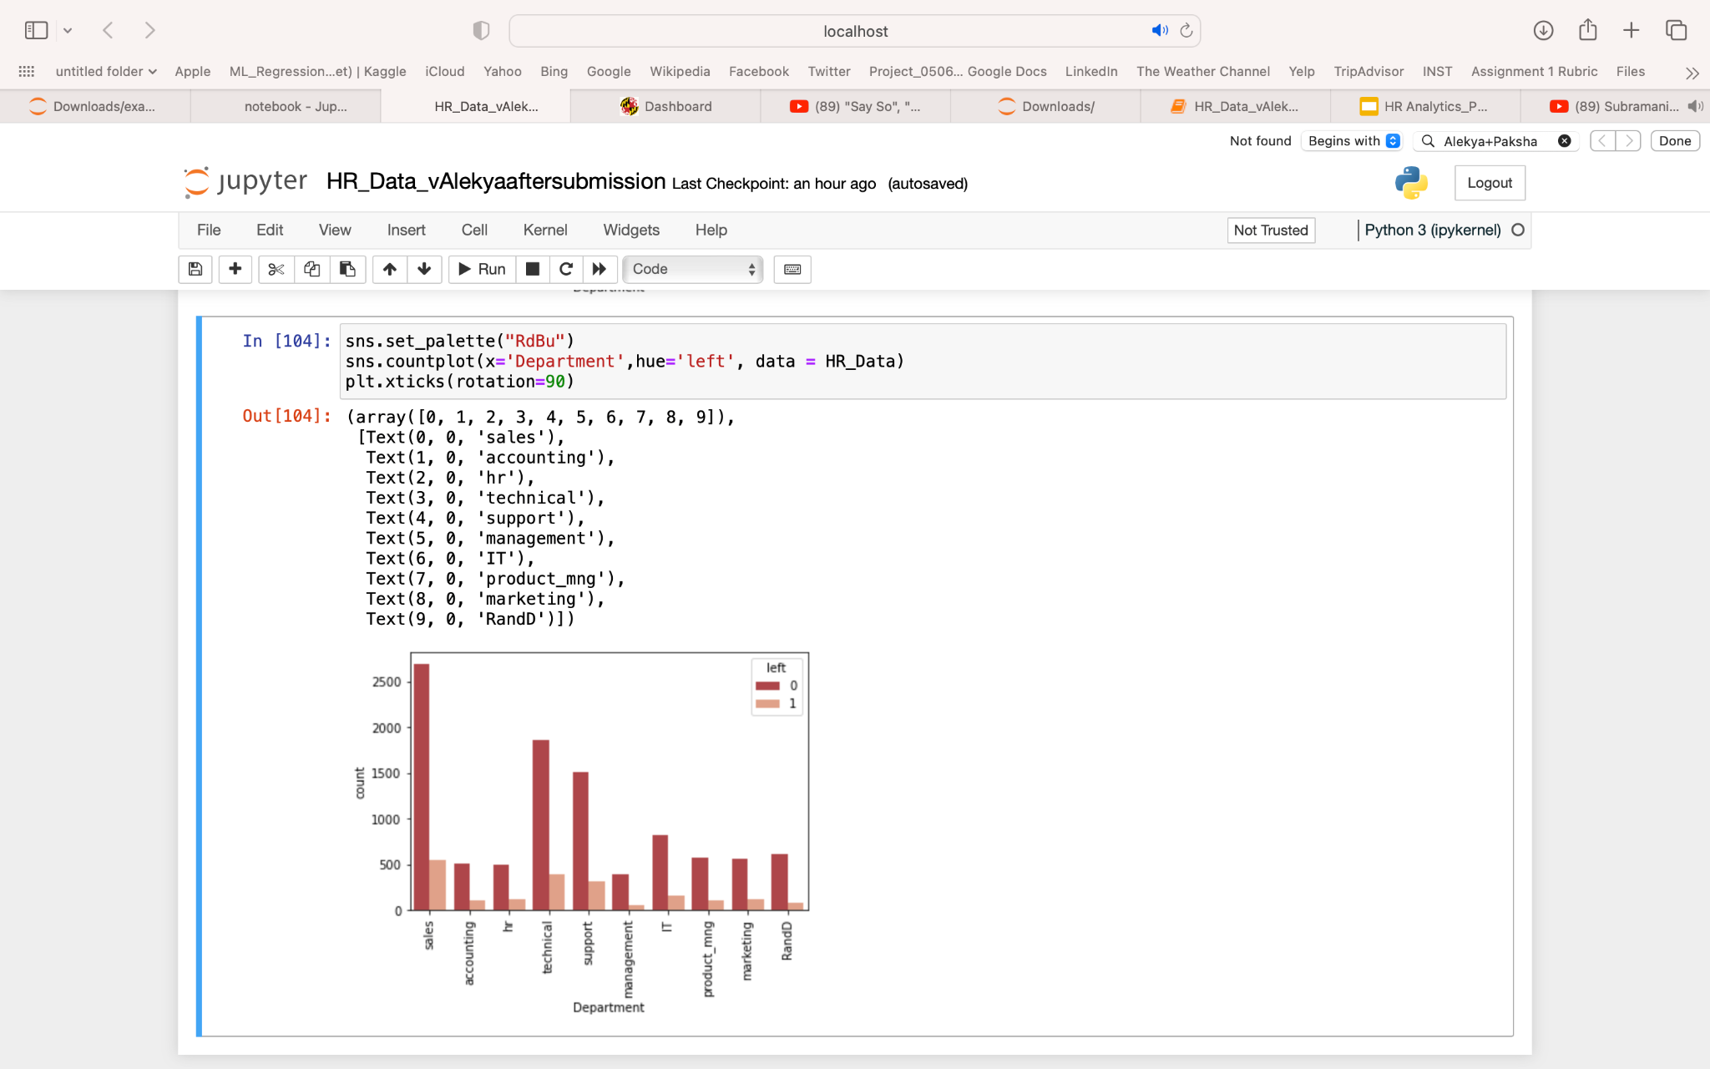
Attrition statistics for each department
Employee count by department
Employees left by department

Slide 17

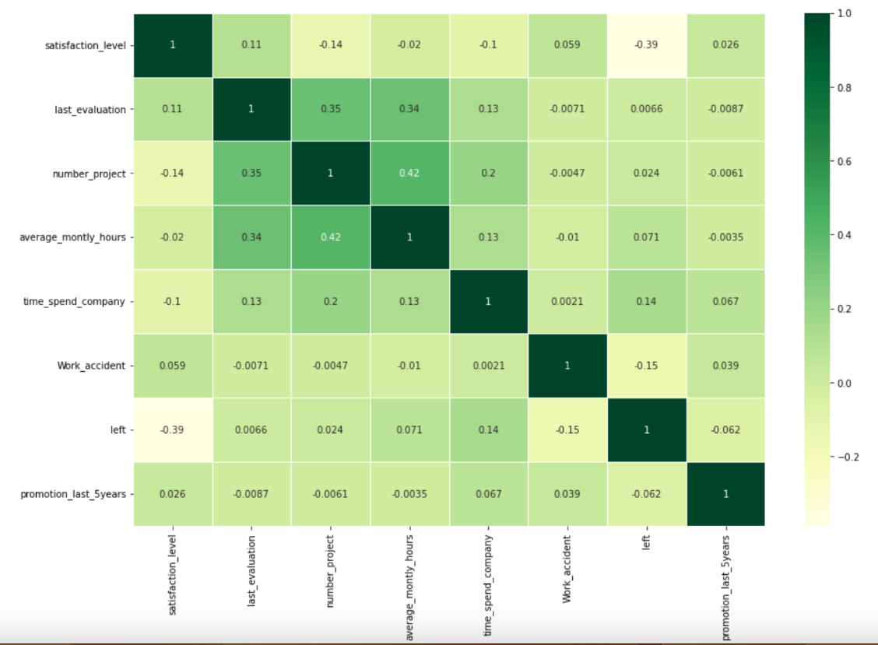
Correlation matrix
Satisfaction level seems to be the most strongly negatively correlated with an employee leaving company
Last evaluation seems to be the variable which is least correlated with an employee leaving company

Slide 18
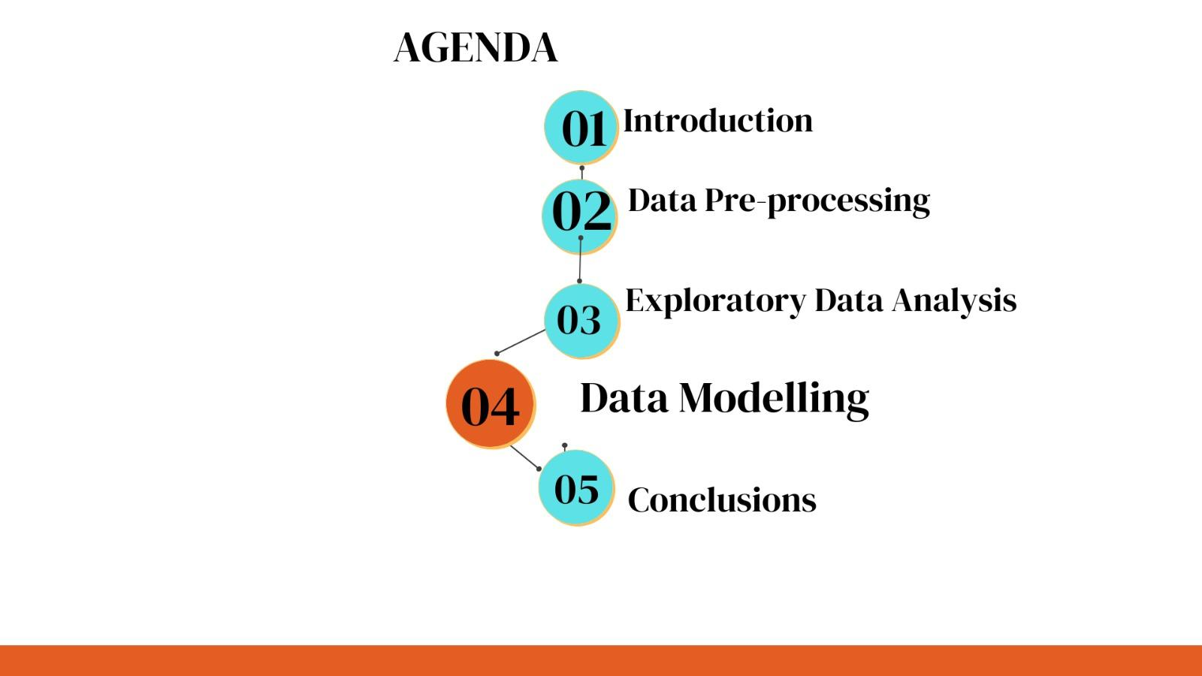

Slide 19

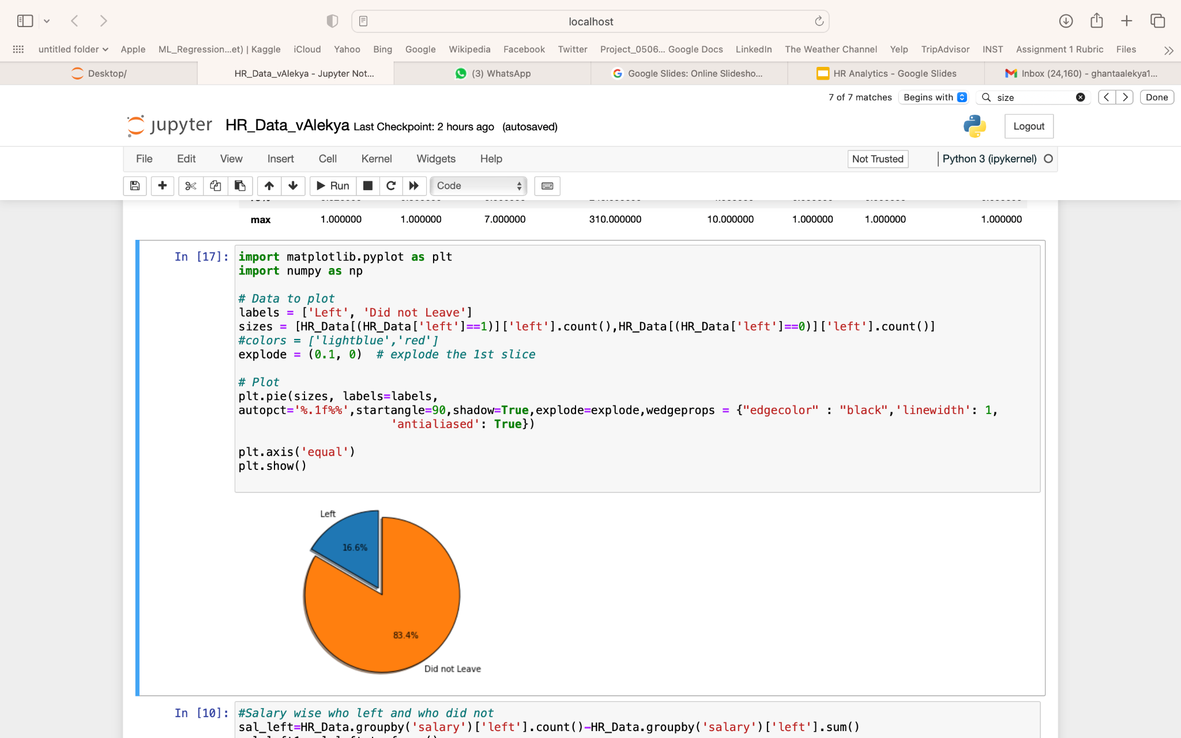
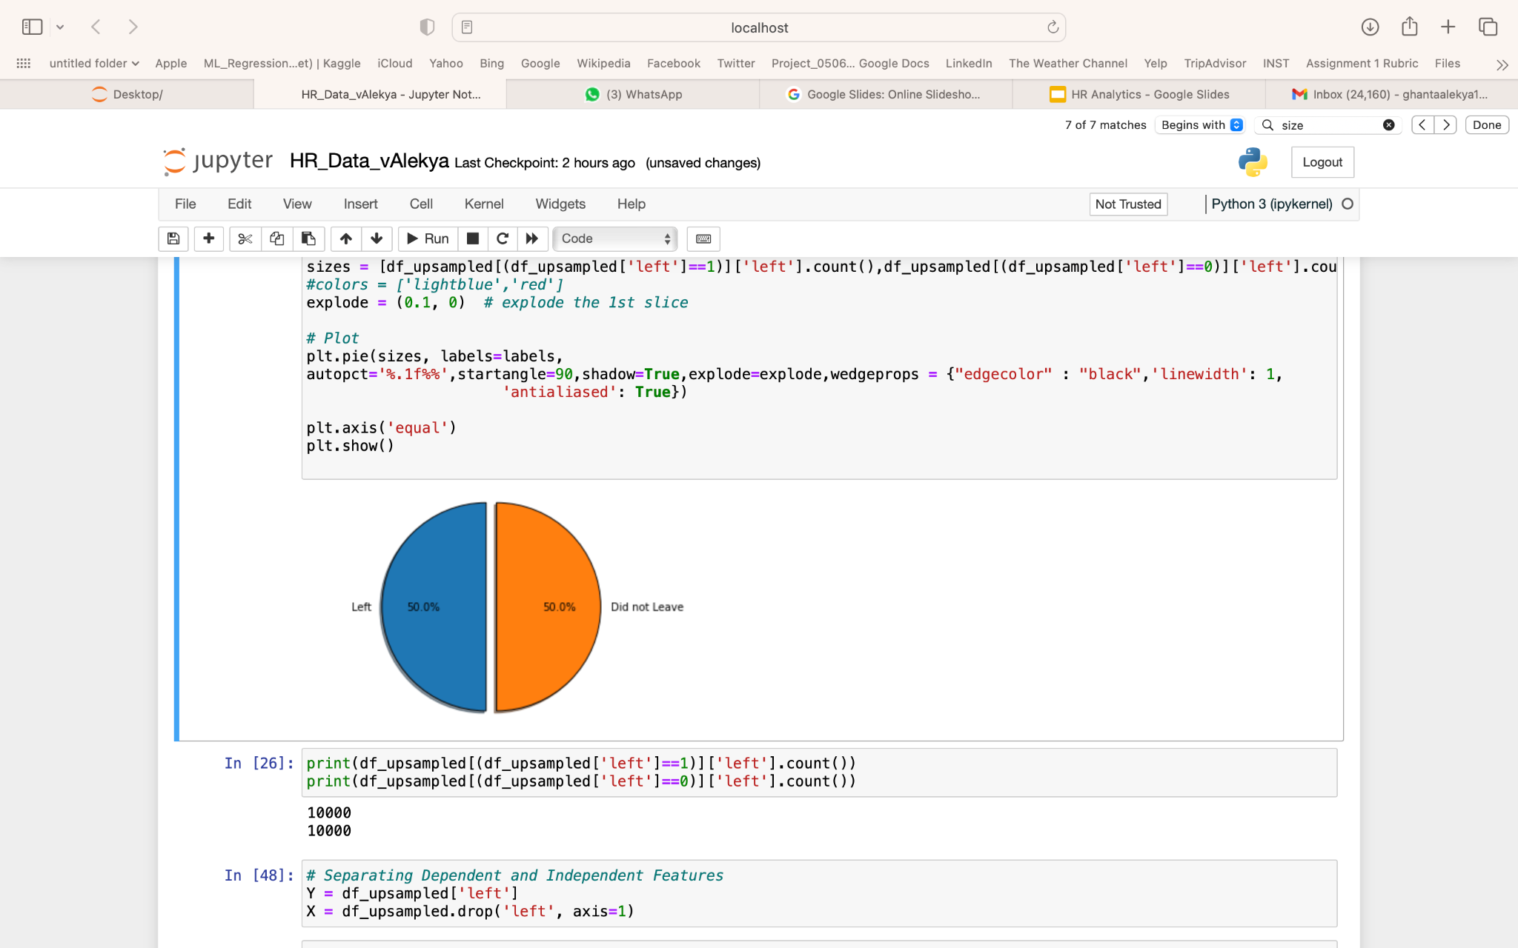
Class Imbalance & Upsampling
There are more number of observations of the Employees who did not leave class
Oversampling is chosen due to low number of observations in the dataset
Upscaled the Employees left class using resample() function
Raw Data (Before Upsampling)
Data (After Upsampling)

Slide 20

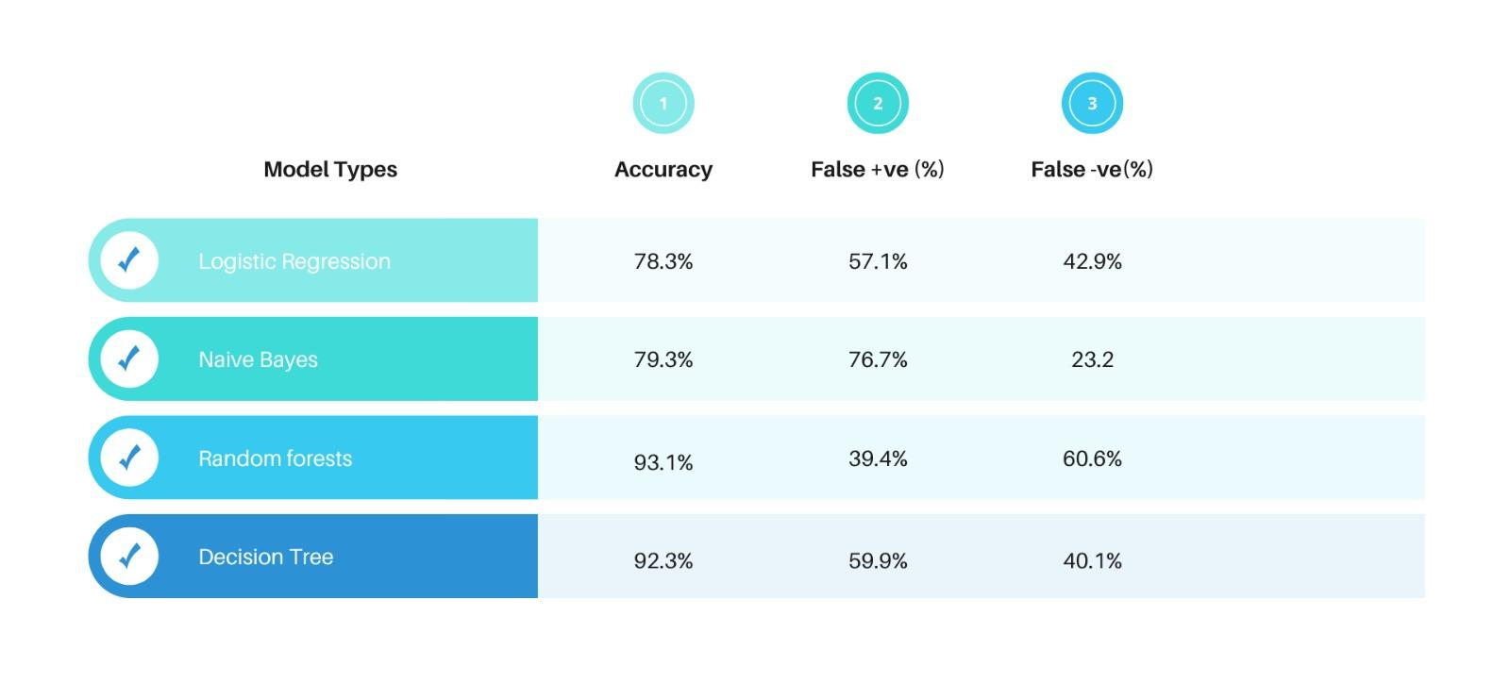
Model Performance Comparison
%

Slide 21
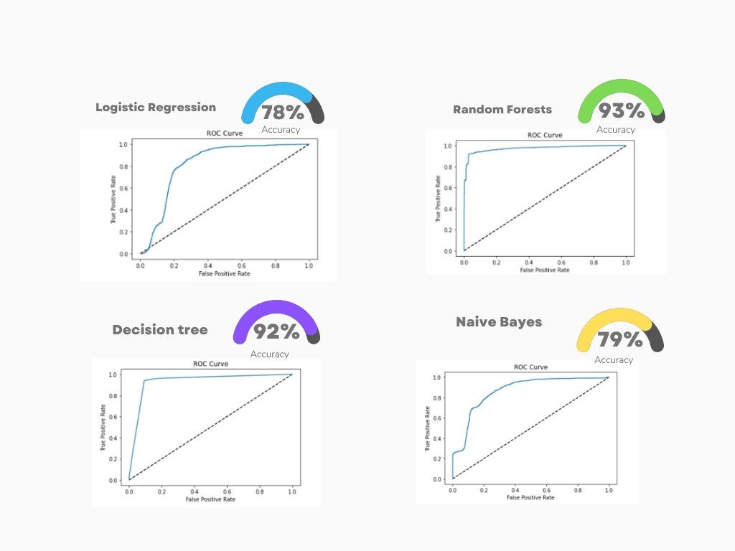
The ROC Curves
RandomForest seems to have the highest accuracy with the most area under the ROC curve representing optimal compromise between sensitivity and specificity, followed by Decision Tree, Logistic Regression and Naive Bayes Models
However, further inspection of overfitting is required to be done on each of the models

Slide 22
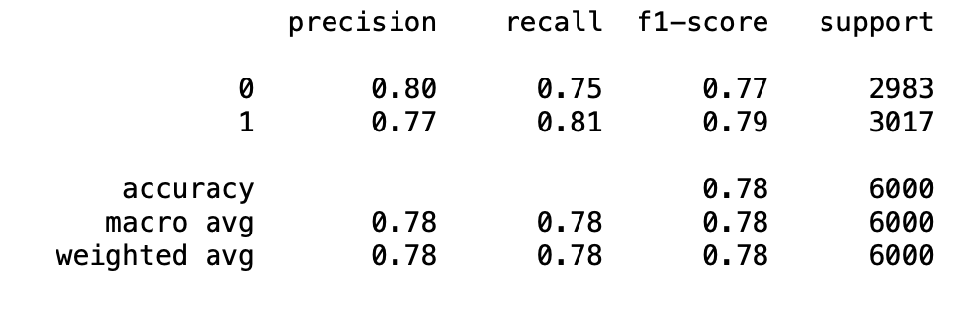
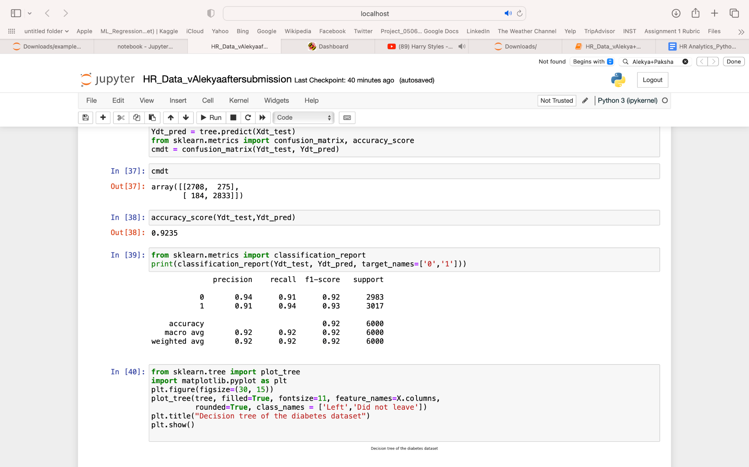
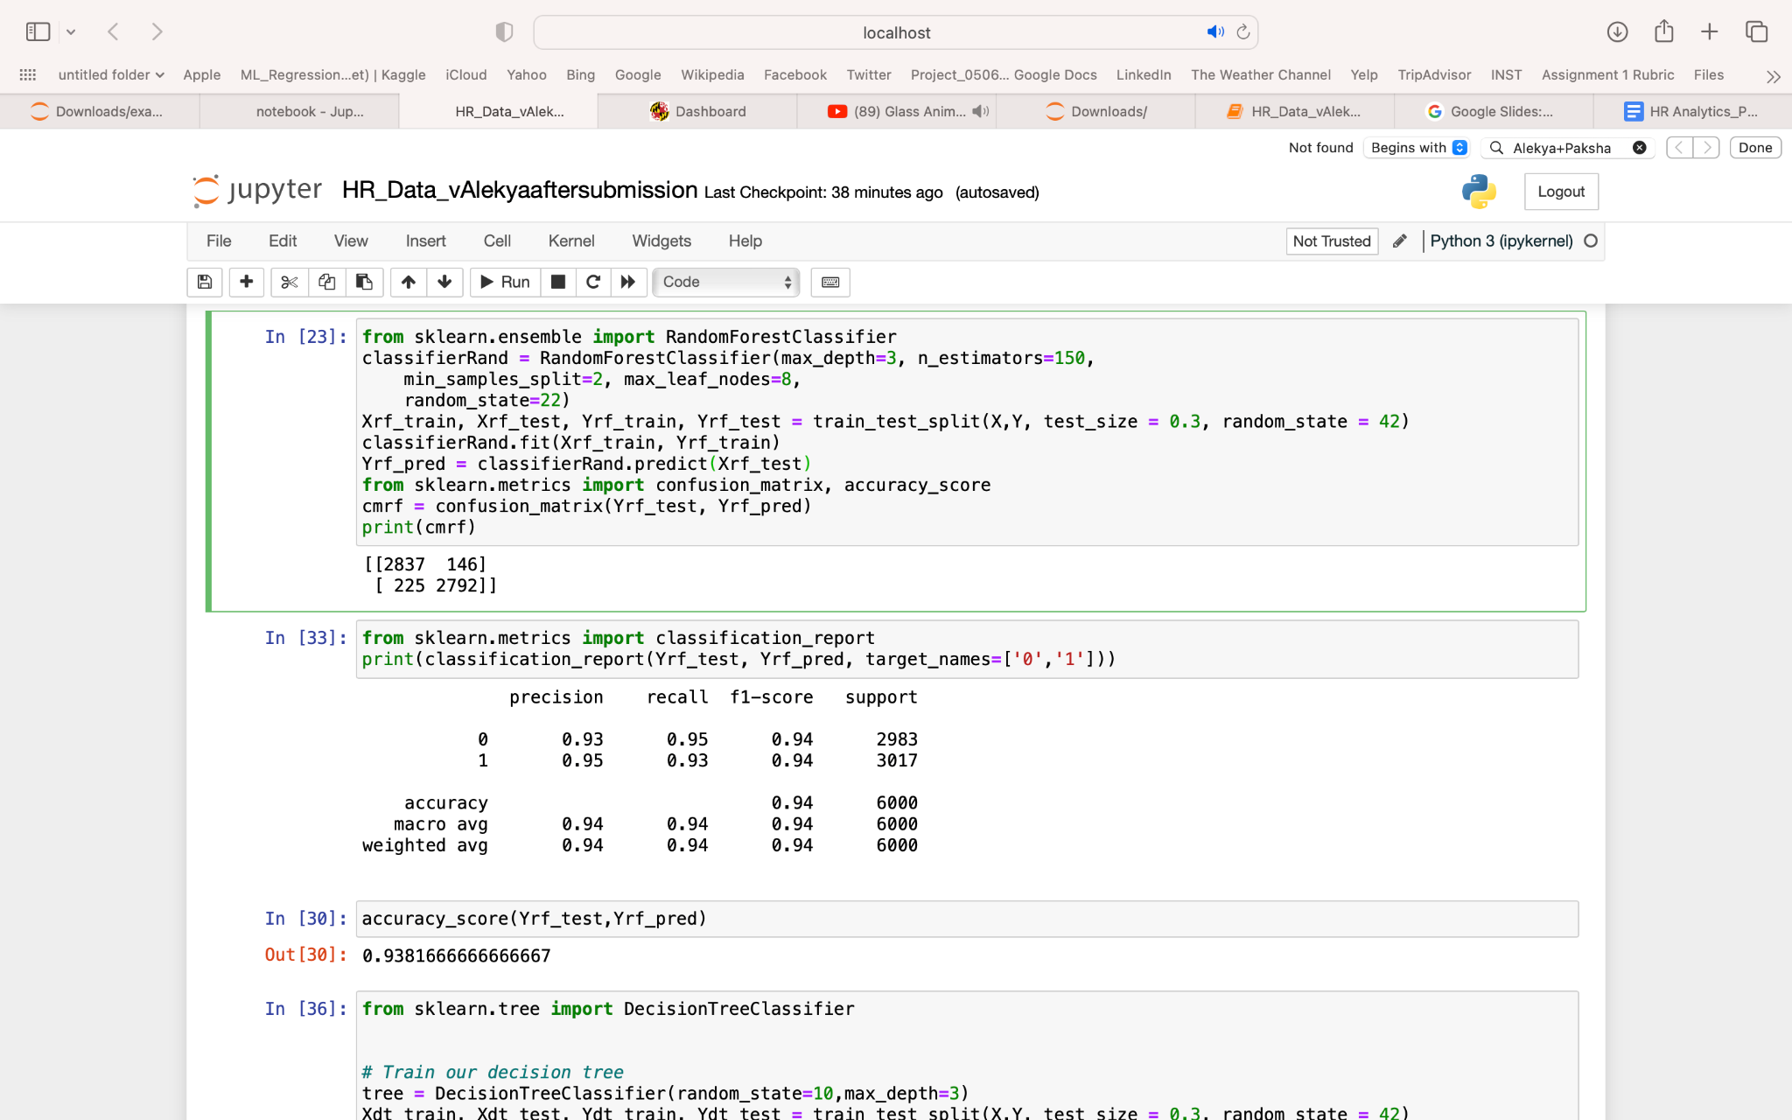
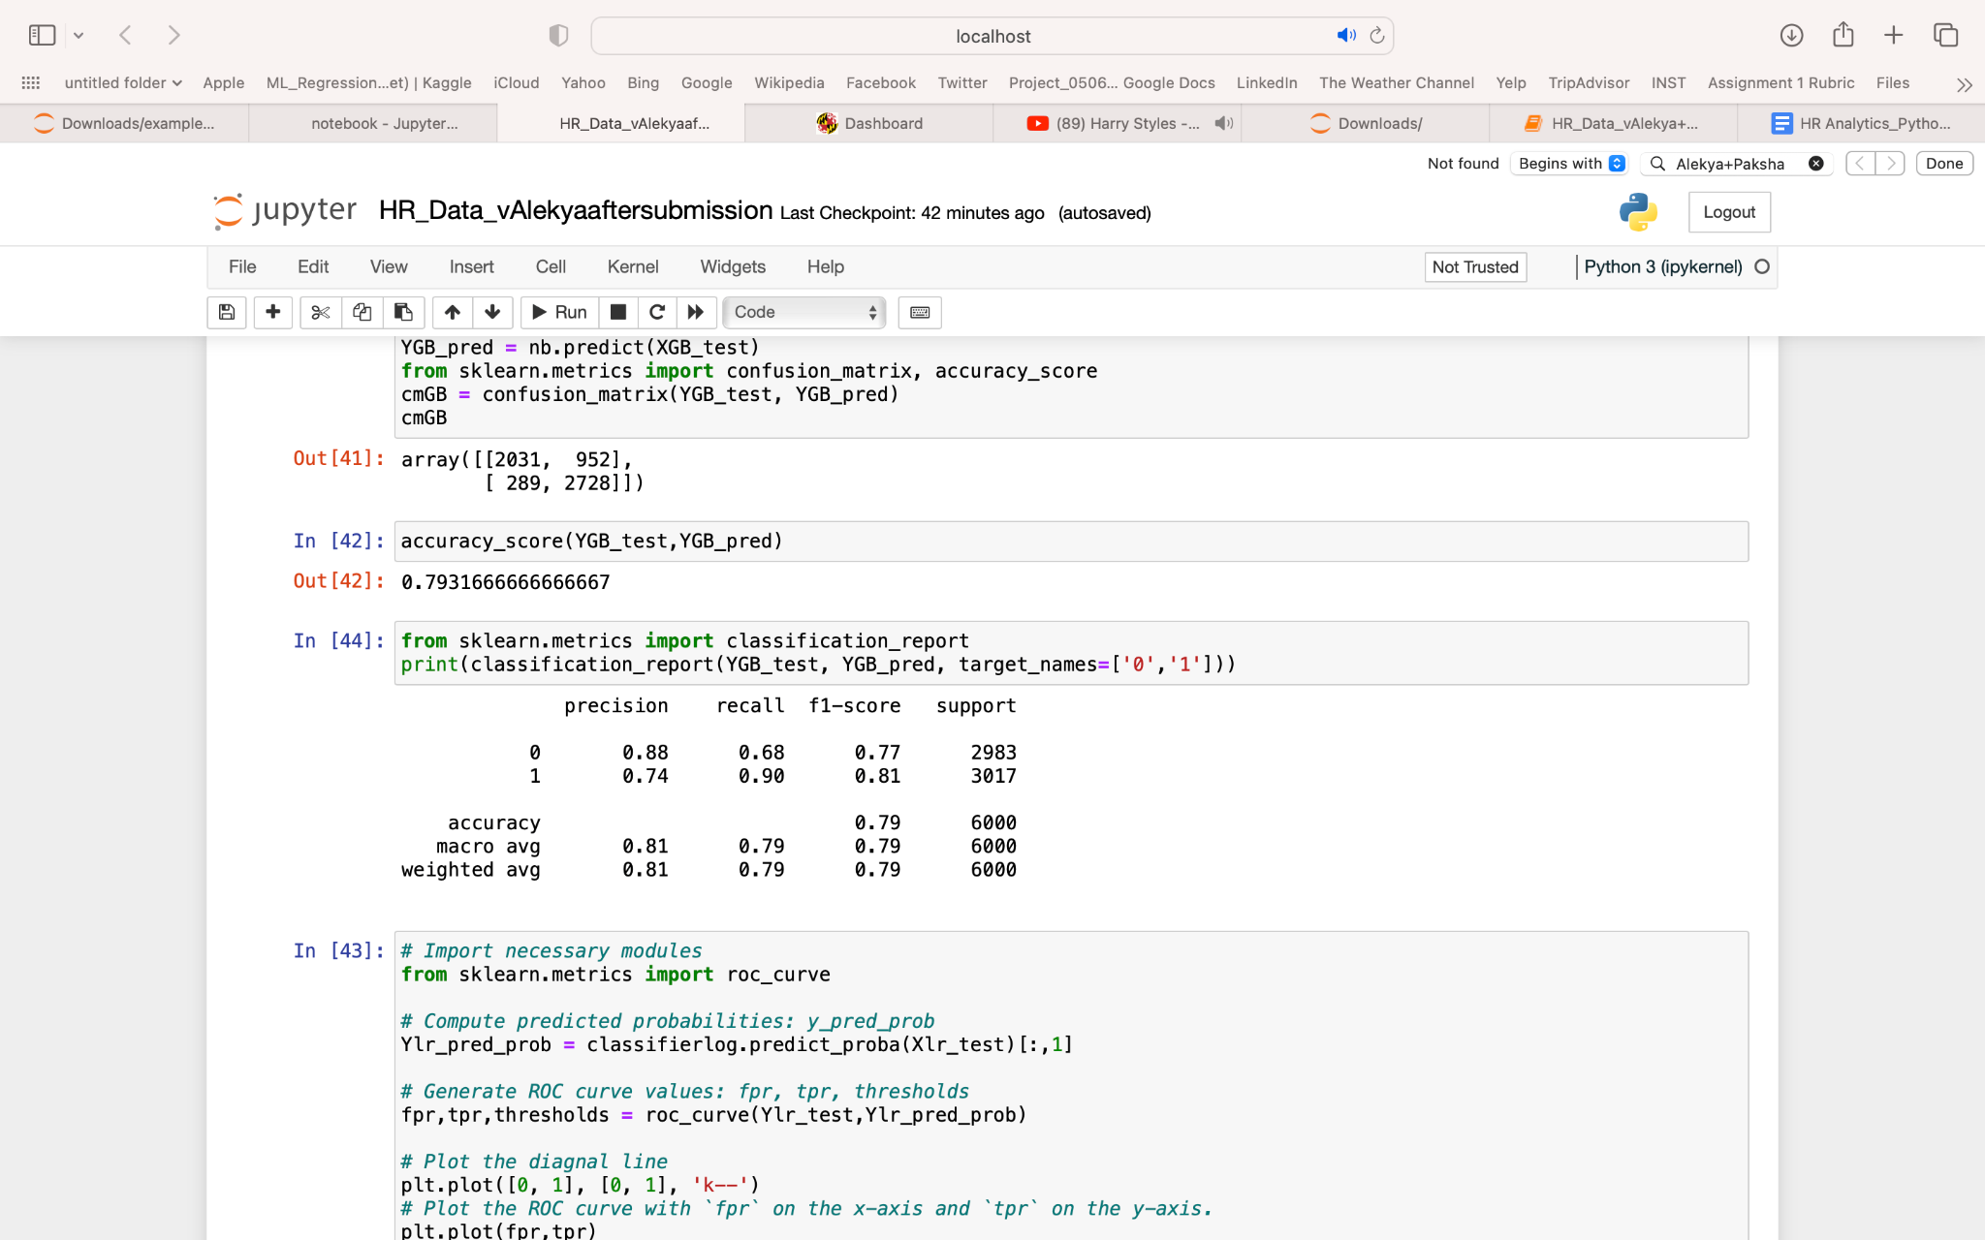
Classification Report
Logistic Regression
Decision Tree
Random Forest
Naive Bayes
Naive Bayes has a very low recall value
Random Forest and Decision Tree have very high accuracy(too good to be true?)
Logistic Regression has modest values compare to others but it is still a good model

Slide 23
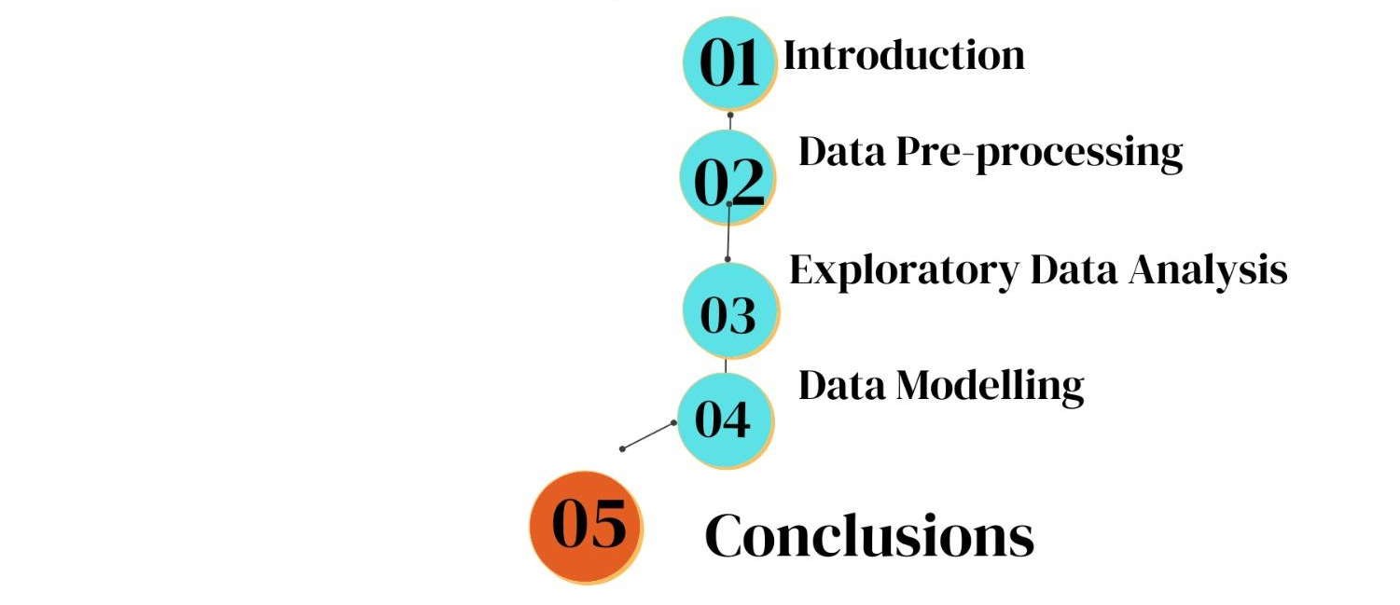

Slide 24

Conclusions
Using EDA, we did some investigations to gain insights and discover patterns
Satisfaction level variable seems to be the most strongly negatively correlated with an employee leaving company
Last evaluation seems to be the variable which is least correlated with an employee leaving company
We created four different models and compared their accuracy
Naive Bayes tend to show a lot of false positives, hence it might not be a suitable model to predict employee attrition
Random Forest & Decision Tree models show good accuracy but still might have overfitting issue after balancing the classes

